Slide 1

Git Installation
Step-by-step installation

Slide 2
Downloading the Git for windows
Git SCM installation

Slide 3
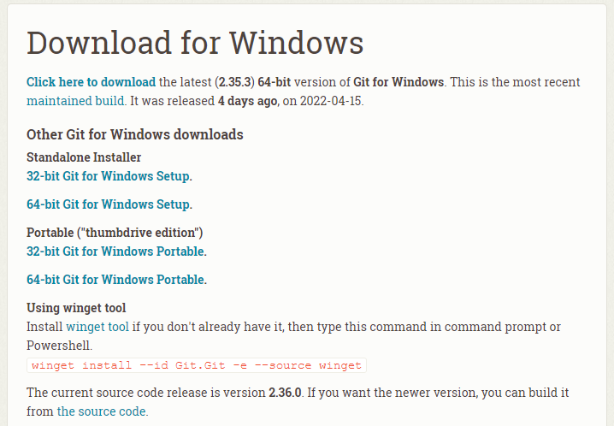
Download Git
https://git-scm.com/download/win

Slide 4
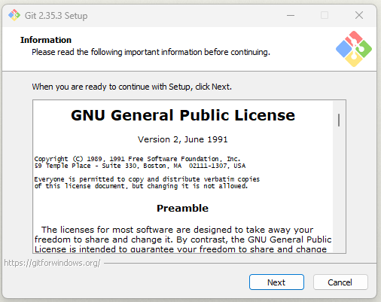
Git Installation
Run the downloaded file

Slide 5
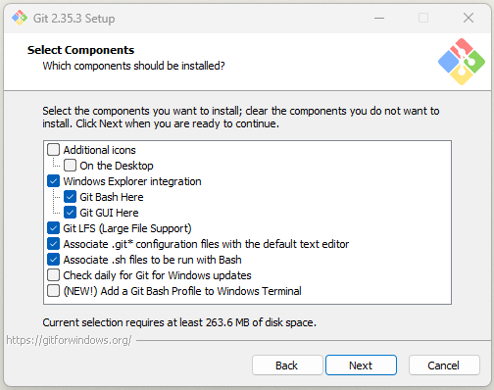
Git Installation

Slide 6
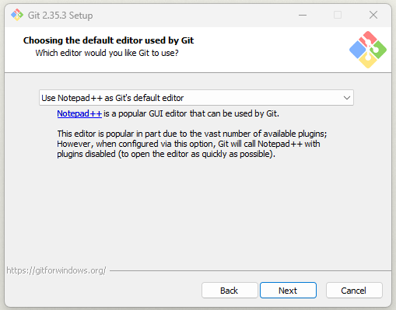
Git Installation

Slide 7
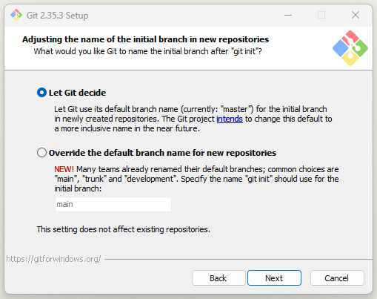
Git Installation

Slide 8
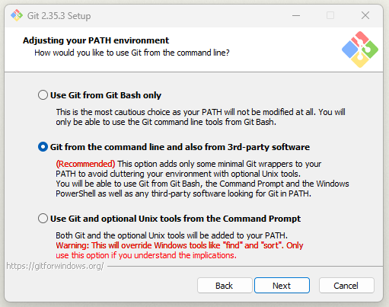
Git Installation

Slide 9
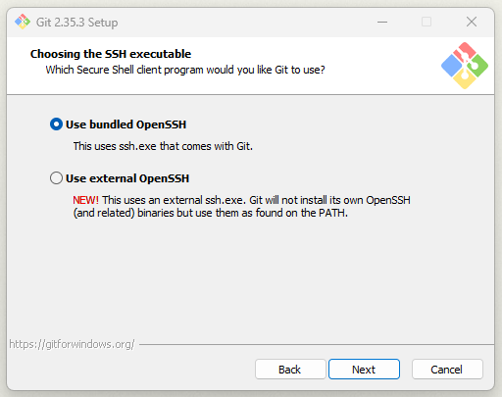
Git Installation

Slide 10
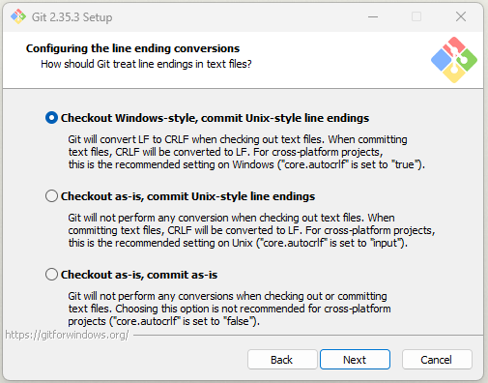
Git Installation

Slide 11
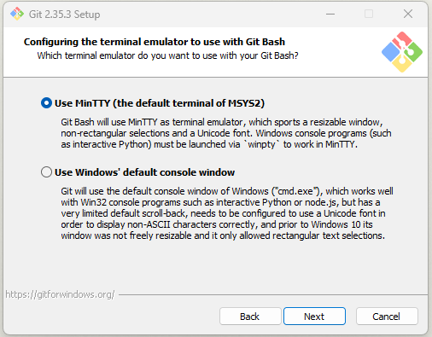
Git Installation

Slide 12
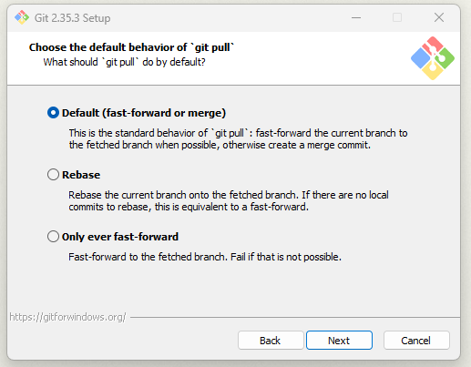
Git Installation

Slide 13
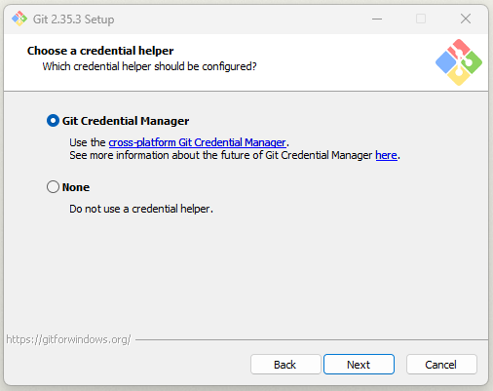
Git Installation

Slide 14
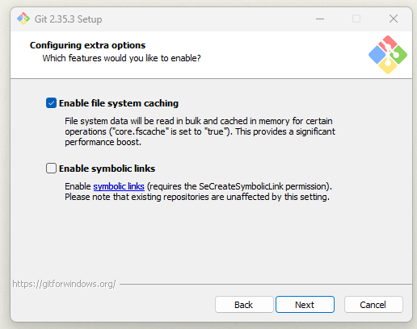
Git Installation

Slide 15
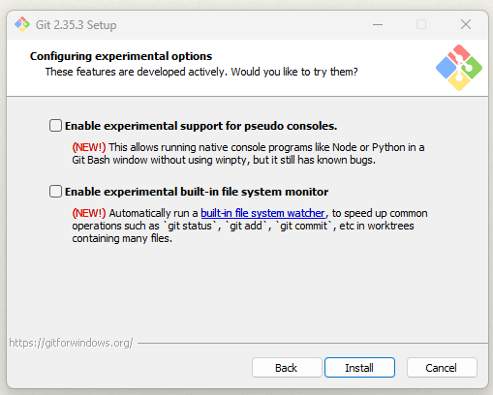
Git Installation

Slide 16
Version Control System
VCS

Slide 17
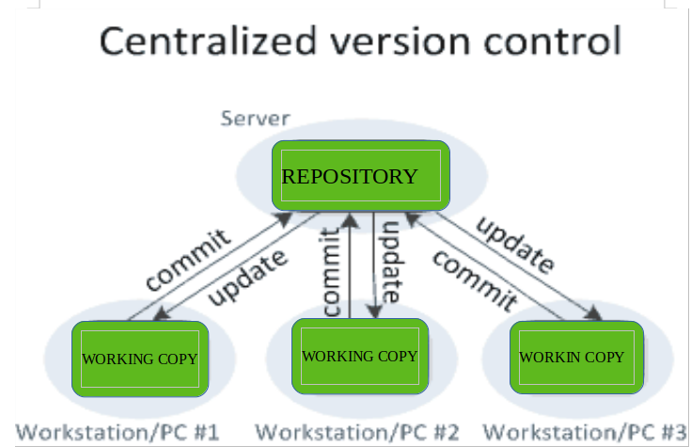
Version Control System (VCS)
VCS:
A category of software tools that help in recording changes made to files by keeping a track of modification done to the code
Benefit:
Efficient collaboration
Leverages productivity
Effective communication and assistance
Reduce possibilities of errors and conflicts
Contribute to the project from any locations
https://www.geeksforgeeks.org/version-control-systems/

Slide 18
Types of VCS
Local Version Control Systems
Use Revision Control System (RCS)
Centralized Version Control Systems
One repository and each user gets their own working copy
You commit, They update
Distributed Version Control Systems
Contain multiple repositories, each user has their own repository and working copy
You commit, You push, They pull, They update
Application: Git, Mercurial, etc.

Slide 19

How to connect to Github
Create a Github Account (https://github.com/)
Windows 10 has updated with built-in Git.
However, in the case that it didn’t work, you need to install Git manually. (as you did previously)
https://git-scm.com/downloads

Slide 20
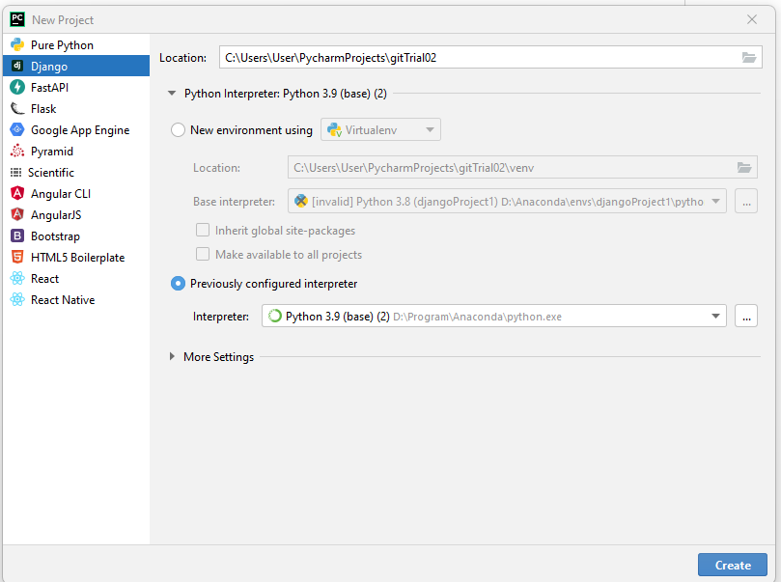
Let’s Create a new Django Project
For this example, let’s create a new Django Project
For example, let’s name the project: GitTrial

Slide 21
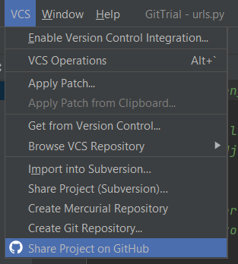
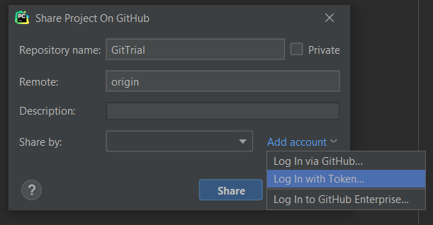
Connect to Github (1)

Slide 22
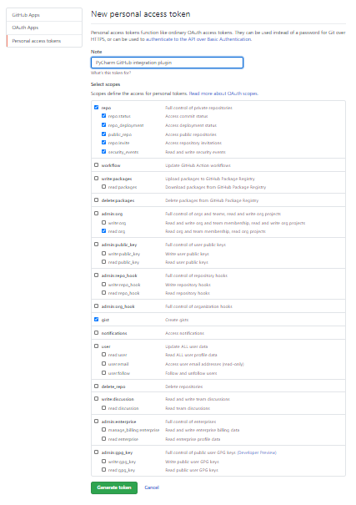
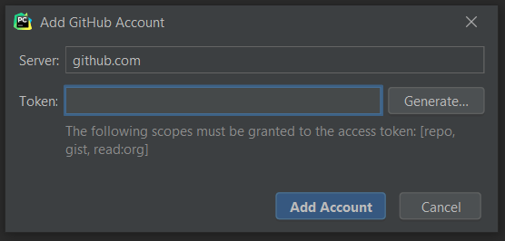
Connect to Github (2)
2
Write a note
1
3

Slide 23
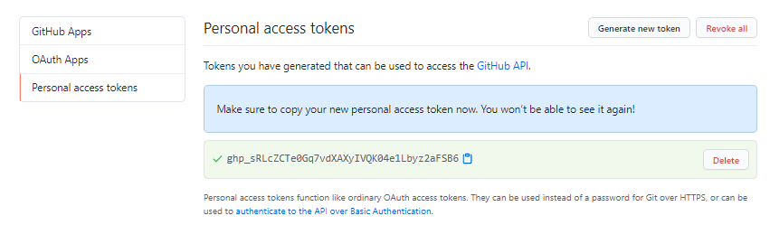
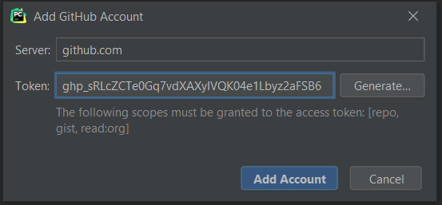
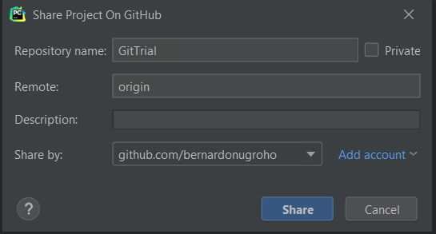
Connect to Github (3)

Slide 24
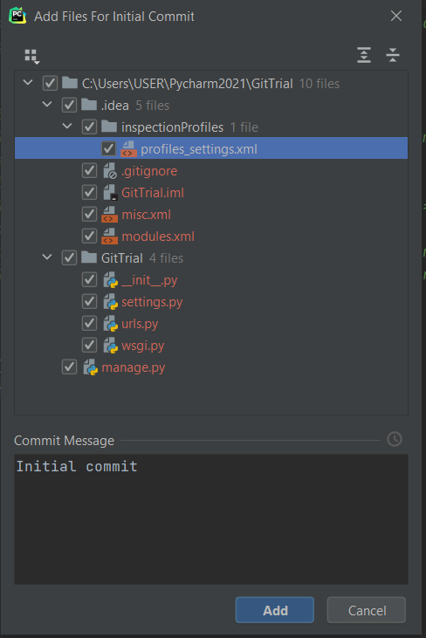
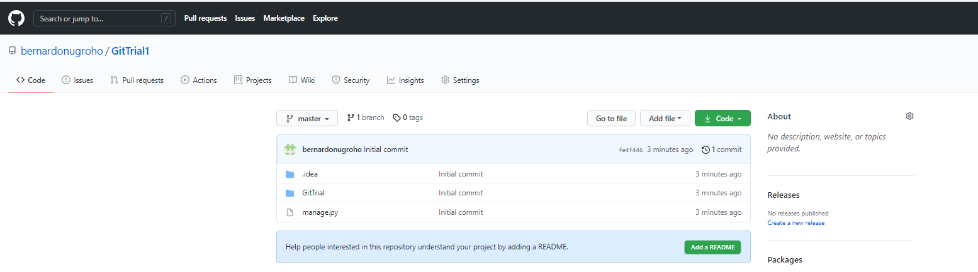
Connect to Github (4)

Slide 25
Modify your code and update your Github
Do any update
Click “Commit” and add the message
Click “Push” to update the remote repository in Github

